Slide 1
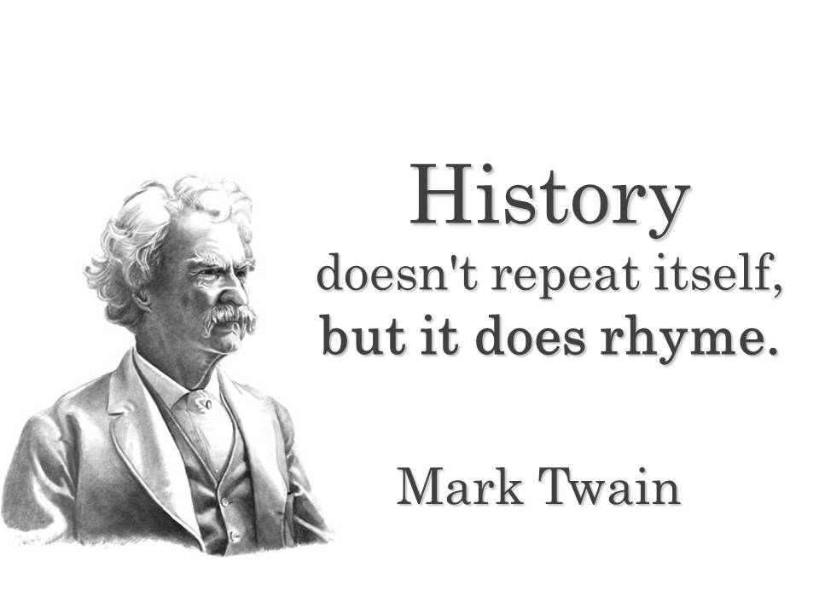
AP United States History
Information for Parents and Students
Teacher: Jennifer Lounibos
Email: jlounibos@petk12.org
Website: lounibos.weebly.com

Slide 2
Goals of the Course
To teach students U.S. history, which is fascinating and explains the world we live in
To develop critical thinking skills such as analysis, argumentation, synthesis, and evaluation
To prepare students for college level academic rigor while still being here to support and guide them
To support student learning while not limiting what they learn
To enable students to pass the APUSH College Board Exam

Slide 3
The APUSH Exam
Designed and administered by the College Board
Costs approximately $91
Usually in early/mid May
Four sections:
Multiple Choice: 55 Qs in 55 minutes (w/sources)
Short Answer: 4 3-part Qs in 50 minutes (w/sources)
Document Based Question Essay: 1 Q/55 minutes (w/sources)
Long Essay: 1 Q in 35 minutes (no sources)
Scores:
1 or 2 = not passing
3 or 4 = passing
5 = highest passing

Slide 4
Benefits of Taking APUSH
Grade bump possible: A=5.0, B=4.0, C=3.0 (but it must be earned)
Score of 3, 4, or 5 can earn college credit (depends on college)
Can save money
Possible higher priority in course registration
Challenging course work:
Learn lots of U.S. history
Develop critical thinking, reading, and writing skills before college
Practice analytical discussions
Helps with taking SAT and other timed or essay-writing tests
College-readiness

Slide 5
Summer Assignment
What?
First 6 chapters of the textbook
Notes and analysis
Very straightforward
Required
Unit test on second day back from school
Why?
College Board expects a high level of historical knowledge
Conquer colonial history before school starts
Helps to pace reading at a manageable level during the school year
Provides a baseline for self-improvement all year

Slide 6
Homework and Classwork
What?
Reading is homework
Approximately 1/2 chapter per class
(Approximately 10-15 pages)
Notes and analysis
Terms (evidence) and context
Chapter quizzes with notes
10 questions in 10 minutes
Why?
Learn content (breadth)
Prepare for class (depth)
Focus on key subjects
Analysis
Evaluation

Slide 7
Unit Tests
What?
Tests are made of parts of the APUSH test
Multiple Choice with documents
Short Answer with documents
Document Based Essay Questions with documents
Long Essay without documents
Timed per the AP test requirements
Why?
Demonstrate knowledge and skills
Build skills and stamina
Prepare for the AP test in May
Practice pacing
Practice using knowledge and skills

Slide 8
Socratic Seminars
What?
30 minute group discussions of historical topics and questions
Questions are given weeks ahead and prepared
Textbook
Provided websites
Why?
Practice using historical knowledge, analysis, and argumentation
Discuss and debate
It’s interesting
Topics:
Jacksonian Democracy
Path to Civil War
Imperialism
Final Review

Slide 9
Exam Preparation
Everything we do all year: reading, quizzes, classwork, tests, Socratic Seminars
A final review Socratic Seminar
Two weeks of optional tutorial and lunch guided study sessions

Slide 10
APUSH Film Fest
Starts after we take the test
Permission slip for movies
All movies are related to subjects we studied throughout the year
Each movie is followed by an analysis of the following:
Argument (thesis) of the movie
Historical evidence
SOAPSTone
Historical accuracy
Semester final (project): group or individual

